Slide 1
Pointer Network
Jia Qi

Slide 2
Contents
What is Pointer Network?
Application 1
—Sentence Ordering
Application 2
—Information Extraction
Conclusion

Slide 3
Motivation
output dictionary:
Pre-defined
Fixed size
Traditional sequence-to-sequence model
e.g.
Machine Translation
（Chinese to English）
A English words dictionary
Impossible to generate words outside the dictionary.

Slide 4
Motivation
你知道“lkjserihtks”是什么意思吗？
Do you know what “lkjserihtks” means?
The output is a combination of the input.
The length of the input is various.
Notes:
There may be some other methods to deal with such problems in machine translation. Here it is just a simple example to show the motivation of pointer network.

Slide 5
Definition
A pointer network is a sequence to sequence model with attention which the output is a position in the input sequence.
Notes:
In other words, it uses attention as a pointer to select a member of the input sequence as the output
The output dictionary size is not fixed. It depends on the number of elements in the input sequence.

Slide 6















Details
$$y_{1}$$
$$y_{2}$$
$$y_{3}$$
$$y_{4}$$
$$z_{1}$$
$$z_{2}$$
$$z_{3}$$
$$z_{4}$$
$$h_{0}$$
$$h_{1}$$
$$h_{2}$$
$$h_{3}$$
$$x_{1}$$
$$x_{2}$$
$$x_{3}$$
Notes:
Seq to seq
But pointer network is not just a seq2seq model, it is combined with the attention mechanism.

Slide 7
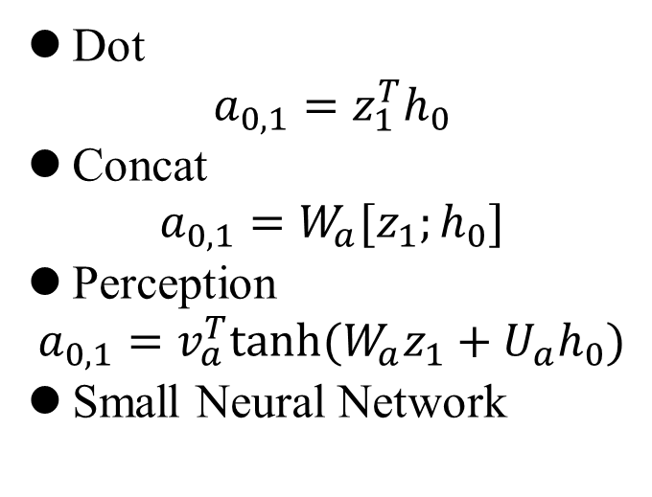


Details
$$a_{0,1}$$
Match
Match
$$z_{1}$$
Dot
$$a_{0,1}=z_{1}^{T}h_{0}$$
Concat
$$a_{0,1}=W_{a}[z_{1};h_{0}]$$
Perception
$$a_{0,1}=v_{a}^{T}tanh⁡(W_{a}z_{1}+U_{a}h_{0})$$
Small Neural Network
$$h_{0}$$
$$h_{1}$$
$$h_{2}$$
$$h_{4}$$
$$x_{1}$$
$$x_{2}$$
$$x_{3}$$
Notes:
Seq to seq
But pointer network is not just a seq2seq model, it is combined with the attention mechanism.

Slide 8

Details
$$a_{1,1}$$
Match
$$z_{1}$$
$$h_{0}$$
$$h_{1}$$
$$h_{2}$$
$$h_{3}$$
$$x_{1}$$
$$x_{2}$$
$$x_{3}$$
Notes:
Seq to seq
But pointer network is not just a seq2seq model, it is combined with the attention mechanism.

Slide 9


Details
$$a_{2,1}$$
Match
$$z_{1}$$
$$h_{0}$$
$$h_{1}$$
$$h_{2}$$
$$h_{3}$$
$$x_{1}$$
$$x_{1}$$
$$x_{3}$$
Notes:
Seq to seq
But pointer network is not just a seq2seq model, it is combined with the attention mechanism.

Slide 10

Details
$$a_{3,1}$$
Match
$$z_{1}$$
$$h_{0}$$
$$h_{1}$$
$$h_{2}$$
$$h_{3}$$
$$x_{1}$$
$$x_{1}$$
$$x_{3}$$
Notes:
Seq to seq
But pointer network is not just a seq2seq model, it is combined with the attention mechanism.

Slide 11
















Details
$${\hat{a}}_{0,1}$$
$${\hat{a}}_{1,1}$$
$${\hat{a}}_{2,1}$$
$${\hat{a}}_{3,1}$$
$$z_{1}$$
Softmax
$$a_{0,1}$$
$$a_{1,1}$$
$$a_{2,1}$$
$$a_{3,1}$$
$$h_{0}$$
$$h_{1}$$
$$h_{2}$$
$$h_{3}$$
$$x_{1}$$
$$x_{2}$$
$$x_{3}$$
Notes:
Seq to seq
But pointer network is not just a seq2seq model, it is combined with the attention mechanism.

Slide 12








Details
$$c_{1}$$
$$y_{1}$$
+
$$z_{1}$$
$$z_{2}$$
$${\hat{a}}_{0,1}$$
$${\hat{a}}_{1,1}$$
$${\hat{a}}_{2,1}$$
$${\hat{a}}_{3,1}$$
$$c_{1}$$
*
*
*
*
$$h_{0}$$
$$h_{1}$$
$$h_{2}$$
$$h_{3}$$
$$x_{1}$$
$$x_{2}$$
$$x_{3}$$
Notes:
Seq to seq
But pointer network is not just a seq2seq model, it is combined with the attention mechanism.

Slide 13


Details
$${\hat{a}}_{0,1}$$
$${\hat{a}}_{1,1}$$
$${\hat{a}}_{2,1}$$
$${\hat{a}}_{3,1}$$
$$x_{2}$$
$$z_{1}$$
$$z_{2}$$
Softmax
$$a_{0,1}$$
$$a_{1,1}$$
$$a_{2,1}$$
$$a_{3,1}$$
$$x_{2}$$
$$h_{0}$$
$$h_{1}$$
$$h_{2}$$
$$h_{3}$$
$$x_{1}$$
$$x_{2}$$
$$x_{3}$$
Notes:
Seq to seq
But pointer network is not just a seq2seq model, it is combined with the attention mechanism.

Slide 14
Application1:Sentence ordering
Goal: to arrange a set of sentences into a coherent text in a clear and consistent manner
Our first question is ……
Overall, ……
Our third question is ……
Our second question is ……
Our first question is ……
Our second question is ……
Our third question is ……
Overall, ……
A set of random sorted sentences
An ordered sequence

Slide 15
Task Description
Given n sentences
The aim is to find the gold order which has the maximal probability of given sentences:
where o indicates any order of these sentences and ψ indicates the set of all possible orders
Notes:
Previous method: pair-wise models?? (Chen el al 2016)decomposing the score to independent pairs
Adavantages: exploit the contextual information; alleviate the error propagation problem

Slide 16
Model Architecture
>
Decoder
Encoder
Sentence Encoder
<

Slide 17
Model Architecture
turns sentences with variational length into a fixed length vector.
Continues bag of word (CBoW)
Convolutional neural networks (CNNs)
Long short-term neural networks (LSTMs)
…
>
Sentence Encoder
<
Notes:
CBoW: simply averages the embeddings of words of a sentence
CNN: capture the features of the sentence with filters and max pooling layer, and finally turns the words’ embedding matrix into a fixed length vector.
LSTM: use the last hidden state to represent the sentence embedding.

Slide 18
Model Architecture
>
Sentence Encoder

Slide 19
Model Architecture
>
Sentence Encoder
<
Notes:
The initial state of the decoder is the latest output of the encoder.

Slide 20
Model Architecture
>
Sentence Encoder
<
Notes:
The initial state of the decoder is the latest output of the encoder.

Slide 21
Model Architecture
>
Sentence Encoder
<

Slide 22
Model Architecture
>
Sentence Encoder
<

Slide 23
Model Architecture
>
Sentence Encoder
<

Slide 24
Model Architecture
>
Sentence Encoder
<

Slide 25
Model Architecture
>
Sentence Encoder
<

Slide 26
Model Architecture
>
Sentence Encoder
<

Slide 27
Model Architecture
>
Sentence Encoder
<

Slide 28
Model Architecture
>
Sentence Encoder
<

Slide 29
Decoder
Greedy Decoding
Beam Search Decoding
Notes:
To find the best order is a NP hard problem.
Instead, we use two strategies to decode a sub optimal results.
One is Greedy Decoding as we have described above, to choose the output with maximum probability at each step.
The other is Beam Search Decoding, we keep the k-top results at each step, and choose the topest score at the last step as the final result.

Slide 30
Training
Loss Function
Indicates a sequence of sentences with a specific permutation
Is in golden order
The regularization term
Notes:
We have m training example, and each is made up of x and y.
Given x and theta, the higher the probabity is , the less loss we get.

Slide 31
Evaluation
Pairwise Metric
PM is the fraction of pairs of sentences whose predicted relative order is the same as the ground truth order.
The higher the better.
the set of all skip bigram sentence pairs of a text
the size of the set

Slide 32
Quiz
What is the precision, recall and F-value?
Notes:
Predict result
True order

Slide 33
Evaluation
Longest Sequence Ratio
The ratio of longest correct sub-sequence
Consecutiveness is not necessary
Higher is better
the number of elements in longest correct sub-sequence

Slide 34
Evaluation
Perfect Match Ratio
The ratio of exactly matching case
Higher is better

Slide 35
Datasets
Abstracts on arXiv (Chen et al. 2016)
SIND (Sequential Image Narrative Dataset) (Ferraro et al. 2016)
Notes:
Examples in SIND dataset all contains 5 sentences, and we only use captions

Slide 36
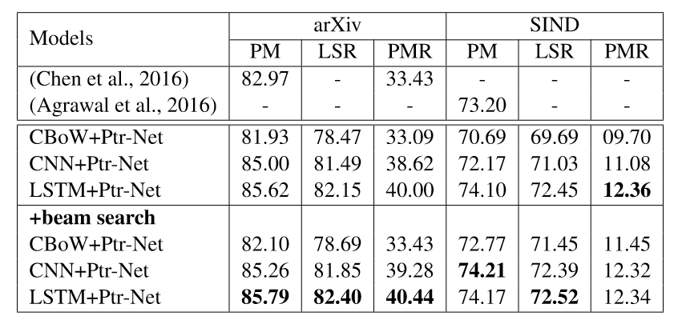
Performance

Slide 37
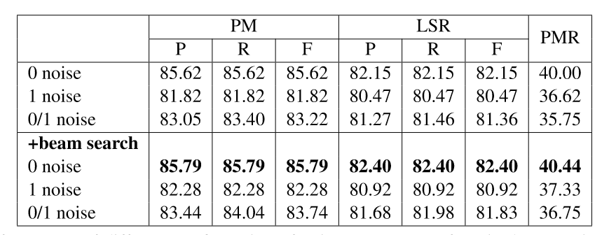
Performance with noises
Noise: the sentence in the input set doesn’t exist in the best ordered sequences
Notes:
Performances of different configuration of noise on test sets of arXiv dataset using Prt-Net with LSTM sentence encoder

Slide 38
Application: Information Extraction
Previous methods:
Rely on token-level labels to find the areas of interest in the text
Time-consuming and costly to create
Not the desired output and just an intermediary step
Barack | Obama | was | born | in | Hawaii
B-1 | L-1 | O | O | O | U-2

Slide 39
End-to-End Information Extraction
Input: raw text --Barack Obama was born in Hawaii
Output: desired output directly –Barack Obama, Hawaii
Without the need for token-level labels
Get competitive results
Notes:
Saving both time and money at comparable performance

Slide 40
Model
cheapest
from
to
Francisco
<GO>
Francisco
<GO>
airfare
Shanghai
San
<EOS>
San
Shanghai
Encoder
Decoder1
Decoder2
Notes:
A single shared encoder
More than one decoders, one for each piece of information we wish to generate

Slide 41

Model
$$a_{1}$$
cheapest
from
to
Francisco
<GO>
airfare
Shanghai
San
<EOS>
San

Slide 42

Model
$$a_{1}$$
$$a_{2}$$
cheapest
from
to
Francisco
<GO>
airfare
Shanghai
San
<EOS>
San

Slide 43

Model
$$a_{1}$$
$$a_{2}$$
$$a_{3}$$
cheapest
from
to
Francisco
<GO>
airfare
Shanghai
San
<EOS>
San

Slide 44





Model
$$a_{1}$$
$$a_{2}$$
$$a_{3}$$
$$a_{4}$$
$$a_{5}$$
$$a_{6}$$
$$a_{7}$$
$$a_{8}$$
cheapest
from
to
Francisco
<GO>
airfare
Shanghai
San
<EOS>
San

Slide 45








Model
$${\hat{a}}_{1}$$
$${\hat{a}}_{2}$$
$${\hat{a}}_{3}$$
$${\hat{a}}_{4}$$
$${\hat{a}}_{5}$$
$${\hat{a}}_{6}$$
$${\hat{a}}_{7}$$
$${\hat{a}}_{8}$$
Softmax
$$a_{1}$$
$$a_{2}$$
$$a_{3}$$
$$a_{4}$$
$$a_{5}$$
$$a_{6}$$
$$a_{7}$$
$$a_{8}$$
cheapest
from
to
Francisco
<GO>
airfare
Shanghai
San
<EOS>
San

Slide 46



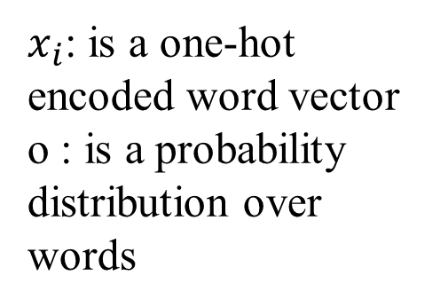

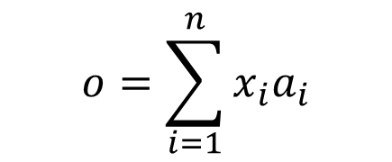




Model
$${\hat{a}}_{1}$$
$${\hat{a}}_{2}$$
$${\hat{a}}_{3}$$
$${\hat{a}}_{4}$$
$${\hat{a}}_{5}$$
$${\hat{a}}_{6}$$
$${\hat{a}}_{7}$$
$${\hat{a}}_{8}$$
$$o=\sum_{i=1}^{n}{x_{i}a_{i}}$$
$x_{i}$: is a one-hot encoded word vector
o : is a probability distribution over words
cheapest
from
to
Francisco
<GO>
airfare
Shanghai
San
<EOS>

Slide 47
Model
$${\hat{a}}_{1}$$
$${\hat{a}}_{2}$$
$${\hat{a}}_{3}$$
$${\hat{a}}_{4}$$
$${\hat{a}}_{5}$$
$${\hat{a}}_{6}$$
$${\hat{a}}_{7}$$
$${\hat{a}}_{8}$$
cheapest
from
to
Francisco
<GO>
airfare
Shanghai
San
<EOS>

Slide 48
Model
cheapest
from
to
Francisco
<GO>
airfare
Shanghai
San
<EOS>
San

Slide 49
Model
cheapest
from
to
Francisco
<GO>
airfare
Shanghai
San
<EOS>
San

Slide 50
Model
cheapest
from
to
Francisco
<GO>
Francisco
airfare
Shanghai
San
<EOS>
San

Slide 51
Model
cheapest
from
to
Francisco
<GO>
Francisco
<GO>
airfare
Shanghai
San
<EOS>
San

Slide 52
Model
cheapest
from
to
Francisco
<GO>
Francisco
<GO>
airfare
Shanghai
San
<EOS>
San
Shanghai

Slide 53
Model
Output:
Destination: San Francisco
Departure: Shanghai
<GO>
Francisco
<GO>
San
Shanghai
Notes:
A single shared encoder
More than one decoders, one for each piece of information we wish to generate

Slide 54
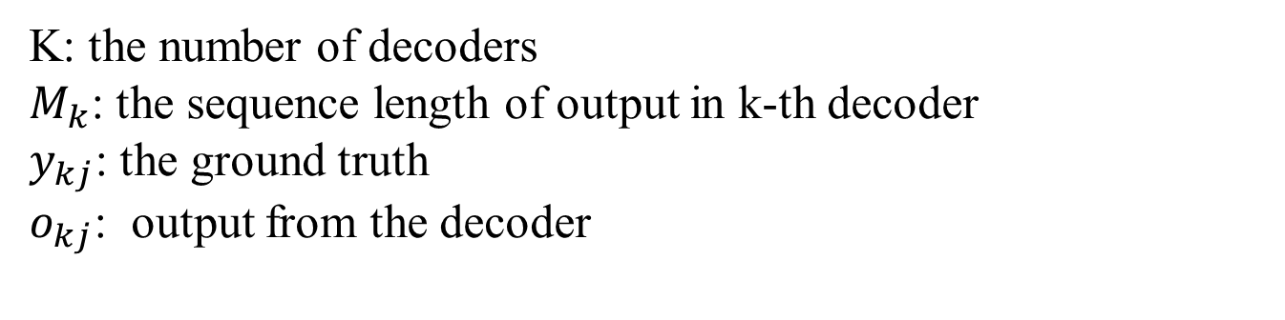
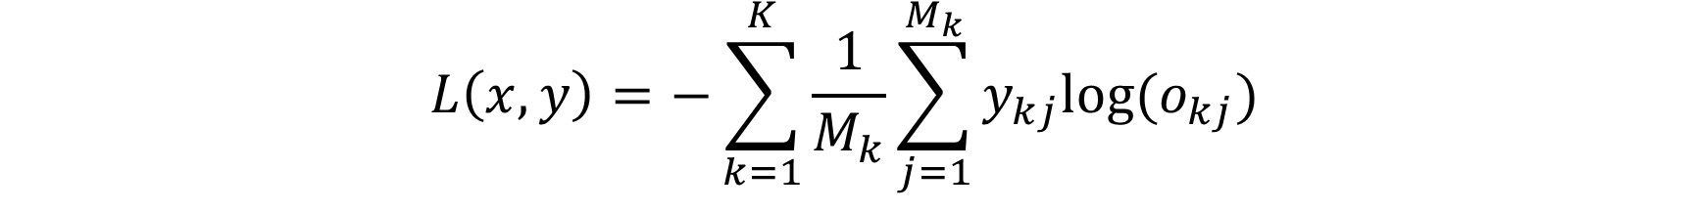
Loss Function
$$L\left(x,y\right)=−\sum_{k=1}^{K}{\frac{1}{M_{k}}\sum_{j=1}^{M_{k}}{y_{kj}log⁡(o_{kj})}}$$
K: the number of decoders
$M_{k}$: the sequence length of output in k-th decoder
$y_{kj}$: the ground truth
$o_{kj}$: output from the decoder

Slide 55
Dataset
Contains token-level labels in the Beginning-Inside-Out format in different domains.
ATIS dataset
The MIT restaurant
Movie corpus
Create an E2E version of each dataset without token-level labels by chunking the BIO-labeled words and using the labels as fields to extract.

Slide 56
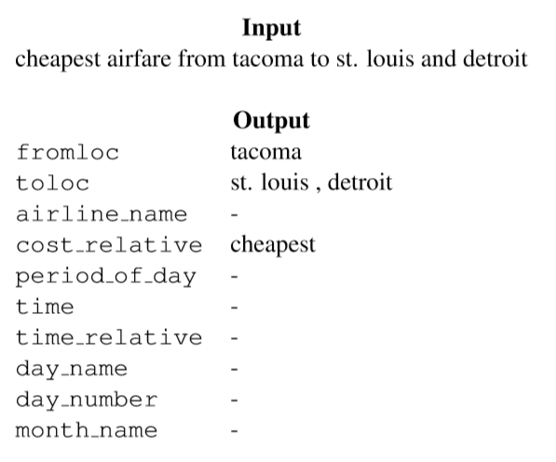
Dataset

Slide 57
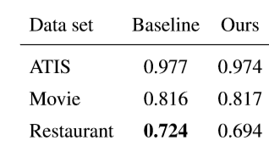
Performance
The end-to-end model is competitive with the baseline models in terms of micro-averaged F1 for two of the three datasets.

Slide 58
Conclusion
Pointer Network can deal with problem without fixed output dictionary, like combination problems.
Applications in NLP: Sentence ordering, Information Extraction, Summarization……

Slide 59
Thank you ~

